Slide 1

****815***
BANNARI AMMAN INSTITUTE OF TECHNOLOGY
S7 Project work – Final review – (23/11/2022)
****REAL-TIME FACE RECOGNITION SYSTEM***
Internal
INTELLIGENCE INNOVATION LAB
**Team details**
Name : AKHILAN S , VARUN P , ABHINESH P V
Reg.No : 191CS112 , 191EE253 , 191CS104
Dept : CSE, EEE, CSE
**Guide details**
Name : DR. NIRMALADEVI J
Designation : ASSOCIATE PROFESSOR
Dept : INFORMATION SCIENCE AND ENGINEERING

Slide 2
Problem Statement
COMMERCIAL USE
Day Care
Residential Security
Banking
Tourism
To check or identify the known person and the unknown person in secure places which is in Real-Time.

Slide 3
AIM AND OBJECTIVE OF THE PROJECT
AIM :
Detecting Human face recognition using AI
OBJECTIVE :
Identifying the face of the subject .
By using Haar Cascade algorithm to train the model .
And display the label of subject in real time .

Slide 4
Scope of the Project
This could be helpful in detecting the authorised and unauthorised
persons.
It enhances the security of the organisation or facility.

Slide 5

NEED FOR THE CURRENT STUDY
Security is the main reason for implementing this system.
This method helps in successing the access of the authorised person.
Prevents from the unidentified persons.

Slide 6
Proposed Methodology
By Collection of Real-Time dataset from the scratch .
Chosen to Use Haar cascade .
Train the Algorithm to recognise the person .
Identified students are grouped and labelled .
Unidentified persons will be saved into different labels as unidentified1 , Unidentified2 etc .

Slide 7
REQUIREMENTS FOR IMPLEMENTATION
Hardware | WEBCAM
Software | IDLE
Programming language | Python
Algorithm | Haar cascade
Dataset | VGG dataset

Slide 8
ALGORITHMS
Haar cascade is an algorithm that can detect objects in images, irrespective of their scale in image and location. This algorithm is not so complex and can run in real-time

Slide 9
CONTRIBUTION TO THE PROJECT
Analysis of Different Algorithms.
Analysing the working of webcam.
Select suitable dataset for the process.
Analysing the suitable changes for better performance.

Slide 10
NOVELTY OF THE PROJECT
Showing real time informations about the subject.
Huge amount of subjects can be observed and identified using this technique.

Slide 11
Cost Benefit Analysis
The requirements are limited so we haven’t used any object.
The only requirement was webcam and sufficient system configuration.

Slide 12

Flow Chart
IDENTIFYING OR VERIFYING
FEATURES EXTRACTION
FACE DETECTION
INPUT DEVICES
FACE DATABASE

Slide 13
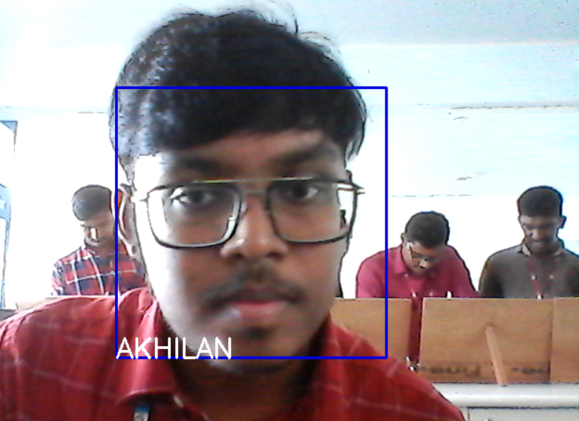
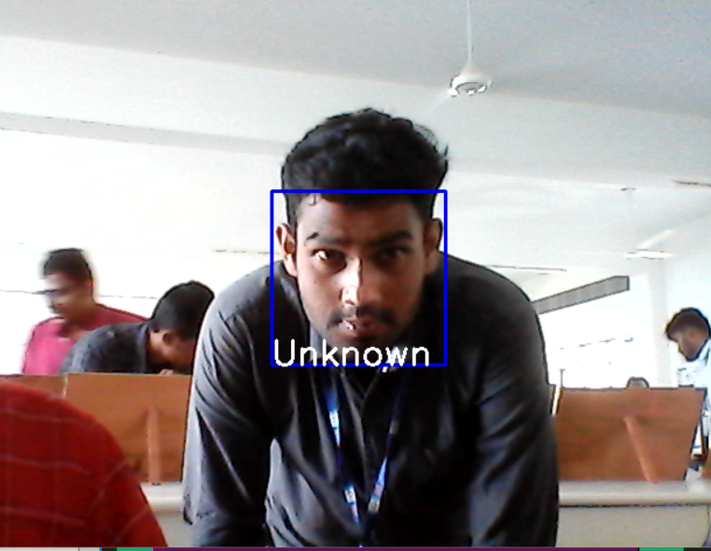
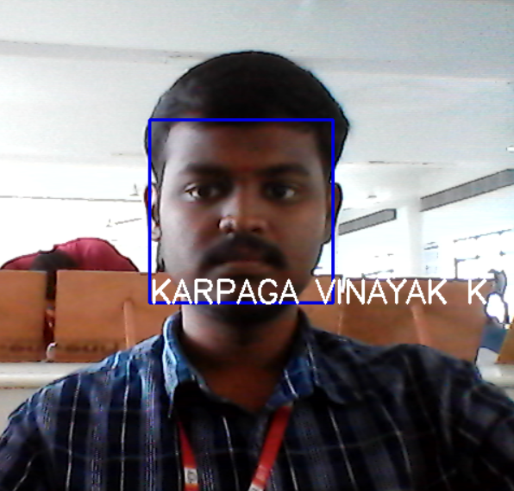
Results

Slide 14
PROGRESS OF WORK- GANTT CHART
 | Weekly Activities
 | 1 | 2 | 3 & 4 | 5 & 6 | 7 | 8 & 9 | 10 & 11 | 13 | 14 & 15 | 16
Selection of Domain and Project Title (Via Literature Surveys) Study the fundamentals of selected Domain, Aim & Objectives of the project, and an insight view of the project | 20.07. 2022
Confirmation of Identified Project Domain and Title - Zeroth Review (Project Work Confirmation Form) |  | 26.07.2022
First Review |  |  |  | 08.09. 2022

Slide 15
LITERATURE SURVEY
https://medium.com/@iselagradilla94/how-to-build-a-face-detection-application-using-pytorch-and-opencv-d46b0866e4d6
https://medium.com/@iselagradilla94/multi-task-cascaded-convolutional-networks-mtcnn-for-face-detection-and-facial-landmark-alignment-7c21e8007923
https://github.com/ShantanuGeekHub/Live_Face_Detection/blob/main/Live_Face_Detector.py

Slide 16
THANK YOU

